Slide 1
Data Science Challenge 2.0
Dana Baimirova

Slide 2

Data Science
Why is it important

Slide 3


Mental health of adolescents
1 in 5 adolescents experience mental disorder.
Self-harm is a third leading cause of death.
Depression is one of the leading causes of disability.

Slide 4
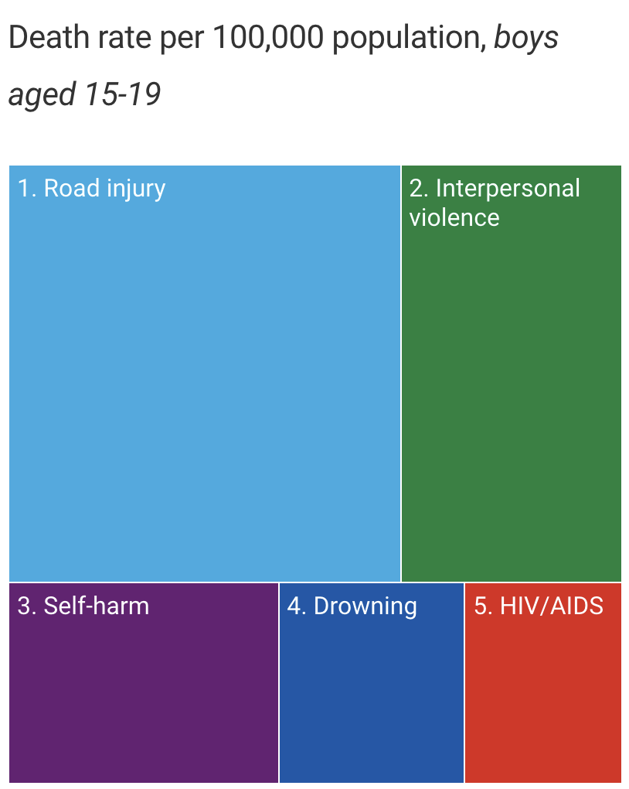
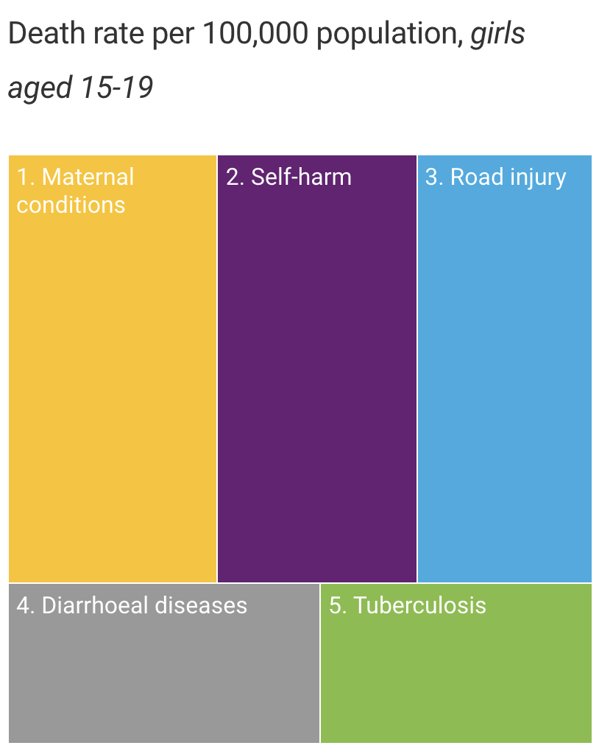
Death Rates Among Adolescents
※ Road injury 25.3 and 8.3
※ Interpersonal violence 14.3
※ Self-harm 8.4 and 9.4
※ Drowning 5.8
※ HIV/AIDS 4.9
※ Maternal Conditions 9.9
※ Diarrhoeal diseases 5.5
※ Tuberculosis 4.8

Slide 5
Key Problems
2/3 of countries have no data for any mental disorder, and that data for mental disorders in those aged 5–17 years are available for only 6·7% of these countries.
According to World Health Statistics, half of deaths have no recorded cause. It is clear there is a need for improved hospital records, health surveys, and vital registration systems among other data sources.

Slide 6
Recommendations
We encourage the government to collect data about population's mental health state.
It is clear there is a need for improved hospital records, health surveys, and vital registration systems among other data sources.

Slide 7
Solution
The main issue in resolving any problems related to mental health of adolescents is absence of any data.
Solving this issue is the first and the biggest step, because without data, data scientists cannot start their work.

Slide 8

There is a gap of validated tools and prevalence data for measurement of adolescent mental health conditions at the population level.
UNICEF, with the support of experts, is working towards filling this gap by developing a tool for use in household surveys to assess the prevalence of mental ill-health among adolescents age 10-19.

Slide 9
MMAP
The Measurement of Mental Health Among Adolescents
at the Population Level
Adolescent anxiety and depression scale (AD)
Functional impairment (FX)
Suicide ideation and attempt (SU)

Slide 10
Thank you for Your attention

